Slide 1
THE WEB-USER SIDE

Slide 2
Browser Security Issues
Security issues for browsers arise from several complications to that simple description, such as these:
A browser often connects to more than the one address shown in the browser’s address bar.
Fetching data can entail accesses to numerous locations to obtain pictures, audio content, and other linked content.
Browser software can be malicious or can be corrupted to acquire malicious functionality.

Slide 3
Popular browsers support add-ins, extra code to add new features to the browser, but these add-ins themselves can include corrupting code.
Data display involves a rich command set that controls rendering, positioning, motion, layering, and even invisibility.
The browser can access any data on a user’s computer, generally the browser runs with the same privileges as the user.
Data transfers to and from the user are invisible, meaning they occur without the user’s knowledge or explicit permission.

Slide 4
Browser Attacks
Assailants go after a browser to obtain sensitive information, such as account numbers or authentication passwords; to entice the user, for example, using pop-up ads; or to install malware.
There are three attack vectors against a browser:
Go after the operating system so it will impede the browser’s correct and secure functioning.
Tackle the browser or one of its components, add-ons, or plug-ins so its activity is altered.
Intercept or modify communication to or from the browser.

Slide 5
Browser Attack Types
Man-in-the-Browser:
A man-in-the-browser attack is an example of malicious code that has infected a browser.
Code inserted into the browser can read, copy, and redistribute anything the user enters in a browser.
The threat here is that the attacker will intercept and reuse credentials to access financial accounts and other sensitive data.
Man-in-the-browse is a Trojan horse that intercepts data passing through the browser.

Slide 6
In January 2008, security researchers led by Liam Omurchu of Symantec detected a new Trojan horse, which they called Silent Banker.
This code linked to a victim’s browser as an add-on or browser helper object; in some versions it listed itself as a plug-in to display video.
As a helper object, it set itself to intercept internal browser calls, including those to receive data from the keyboard, send data to a URL, generate or import a cryptographic key, read a file or connect to a site; this list includes pretty much everything a browser does.

Slide 7
SilentBanker started with a list of over 400 URLs of popular banks throughout the world.
Whenever it saw a user going to one of those sites, it redirected the user’s keystrokes through the Trojan horse and recorded customer details that it forwarded to remote computers.
Banking and other financial transactions are ordinarily protected in transit by an encrypted session, using a protocol named SSL or HTTPS and identified by a lock icon on the browser’s screen.

Slide 8
This protocol means that the user’s communications are encrypted during transit.
But remember that cryptography, although powerful, can protect only what it can control.
Because SilentBanker was embedded within the browser, it intruded into the communication process as shown in Figure 4-2.
When the user typed data, the operating system passed the characters to the browser.

Slide 9
But before the browser could encrypt its data to transmit to the bank, Silent Banker intervened, acting as part of the browser.
This timing vulnerability would not have been countered by any of the other security approaches banks use, such as an image that only the customer will recognize or two-factor authentication.
Furthermore, the URL in the address bar looked and was authentic, because the browser actually did maintain a connection with the legitimate bank site.

Slide 10
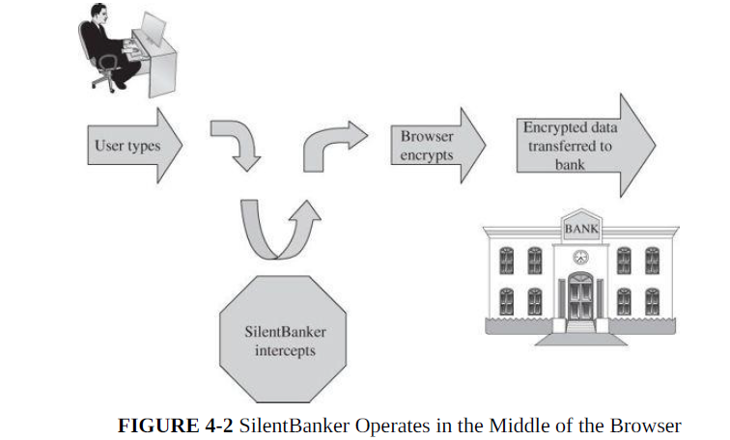

Slide 11
SSL encryption is applied in the browser; data are vulnerable before being encrypted.
As if intercepting details such as name, account number, and authentication data were not enough, Silent Banker also changed the effect of customer actions.
So, for example, if a customer instructed the bank to transfer money to an account at bank A, Silent Banker converted that request to make the transfer go to its own account at bank B, which the customer’s bank duly accepted as if it had come from the customer.
When the bank returned its confirmation, SilentBanker changed the details before displaying them on the screen.
Thus, the customer found out about the switch only after the funds failed to show up at bank A as expected.

Slide 12
A variant of Silent Banker intercepted other sensitive user data, using a display like the details shown in Figure 4-3.
Users see many data request boxes, and this one looks authentic.
The request for token value might strike some users as odd, but many users would see the bank’s URL on the address bar and dutifully enter private data.

Slide 13
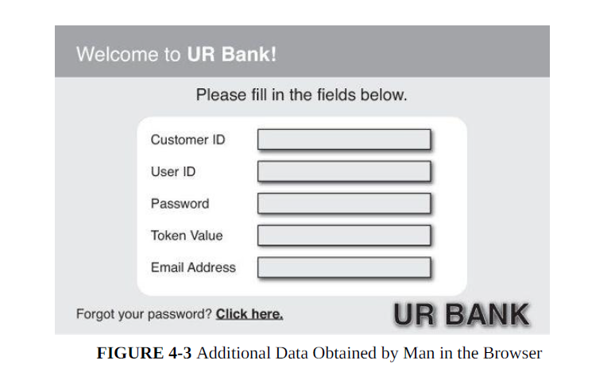

Slide 14
Man-in-the-browser attacks can be devastating because they represent a valid, authenticated user.
The Trojan horse could slip neatly between the user and the bank’s web site, so all the bank’s content still looked authentic.
Silent Banker had little impact on users, but only because it was discovered relatively quickly, and virus detectors were able to eradicate it promptly.
Nevertheless, this piece of code demonstrates how powerful such an attack can be.

Slide 15
Keystroke Logger
Another attack approach that is similar to a man in the browser.
A keystroke logger (or key logger) is either hardware or software that records all keystrokes entered.
The logger either retains these keystrokes for future use by the attacker or sends them to the attacker across a network connection.
As a hardware device, a keystroke logger is a small object that plugs into a USB port, resembling a plug-in wireless adapter or flash memory stick.
Of course, to compromise a computer you have to have physical access to install (and later retrieve) the device.

Slide 16
You also need to conceal the device so the user will not notice the logger (for example, installing it on the back of a desktop machine).
In software, the logger is just a program installed like any malicious code.
Such devices can capture passwords, login identities, and all other data typed on the keyboard.
Although not limited to browser interactions, a keystroke logger could certainly record all keyboard input to the browser.

Slide 17
Page-in-the-Middle
page-in-the-middle attack is another type of browser attack in which a user is redirected to another page.
Similar to the man-in-the-browser attack, a page attack might wait until a user has gone to a particular web site and present a fictitious page for the user.
As an example, when the user clicks “login” to go to the login page of any site, the attack might redirect the user to the attacker’s page, where the attacker can also capture the user’s credentials.
The admittedly slight difference between these two browser attacks is that the man-in the- browser action is an example of an infected browser that may never alter the sites visited by the user but works behind the scenes to capture information.
In a page-in-the middle action, the attacker redirects the user, presenting different web pages for the user to see.

Slide 18
Program Download Substitution
Coupled with a page-in-the-middle attack is a download substitution.
In a download substitution, the attacker presents a page with a desirable and seemingly innocuous program for the user to download, for example, a browser toolbar or a photo organizer utility.
What the user does not know is that instead of or in addition to the intended program, the attacker downloads and installs malicious code.

Slide 19
The advantage for the attacker of a program download substitution is that users have been conditioned to be wary of program downloads, precisely for fear of downloading malicious code.
In this attack, the user knows of and agrees to a download, not realizing what code is actually being installed.
(Then again, users seldom know what really installs after they click [Yes].)
This attack also defeats users’ access controls that would normally block software downloads and installations, because the user intentionally accepts this software.

Slide 20
User-in-the-Middle
A different form of attack puts a human between two automated processes so that the human unwittingly helps spammers register automatically for free email accounts.
A CAPTCHA is a puzzle that supposedly only a human can solve, so a server application can distinguish between a human who makes a request and an automated program generating the same request repeatedly.
Think of web sites that request votes to determine the popularity of television programs.
To avoid being fooled by bogus votes from automated program scripts, the voting sites sometimes ensure interaction with an active human by using CAPTCHAs (an acronym for Completely Automated Public Turing test to tell Computers and Humans Apart—sometimes finding words to match a clever acronym is harder than doing the project itself).

Slide 21
How Browser Attacks Succeed: Failed Identification and Authentication
The central failure of these in-the-middle attacks is faulty authentication. If A cannot be assured that the sender of a message is really B, A cannot trust the authenticity of anything
in the message.
In this section we consider authentication in different contexts:
Human Authentication
Authentication is based on something you know, are, or
possess.
People use these qualities all the time in developing face-to-face authentication.

Slide 22
Examples of human authentication techniques include a driver’s license or identity card, a letter of introduction from a mutual acquaintance or trusted third party, a picture (for
recognition of a face), a shared secret, or a word.
Because we humans exercise judgment, we develop a sense for when an authentication is adequate and when something just doesn’t seem right.
Of course, humans can also be fooled

Slide 23
Computer Authentication
When a user communicates online with a bank, the communication is really user-to browser and computer-to-bank’s computer.
Although the bank performs authentication of the user, the user has little sense of having authenticated the bank.
Worse, the user’s browser and computer in the middle actually interact with the bank’s computing system, but the user does not actually see or control that interaction.
What is needed is a reliable path from the user’s eyes and fingers to the bank, but that path passes through an opaque
browser and computer.

Slide 24
Computer authentication uses the same three primitives as human authentication, with obvious variations.
There are relatively few ways to use something a computer has or is for authentication.
If a computer’s address or a component’s serial number cannot be spoofed, that is a reliable authenticator, but spoofing or impersonation attacks can be subtle.
Computers do not innately “know” anything, but they can remember (store) many things and derive many more.
The problem, as you have seen with topics such as cryptographic key exchange, is how to develop a secret shared by only two computers.

Slide 25
Authentication is vulnerable at several points:
Usability and accuracy can conflict for identification and authentication: A more usable system may be less accurate.
But users demand usability, and at least some system designers pay attention to these user demands.
Computer-to-computer interaction allows limited bases for authentication.
Computer authentication is mainly based on what the computer knows, that is, stored or computable data. But stored data can be located by unauthorized processes, and what one computer can compute so can another.

Slide 26
Malicious software can undermine authentication by eavesdropping on the authentication data and allowing it to be reused later.
Well placed attack code can also wait until a user has completed authentication and then interfere with the content of the authenticated session.
Each side of a computer interchange needs assurance of the authentic identity of the opposing side.
This is true for human-to-computer interactions as well as for computer-to-human.

Slide 27
Successful Identification and Authentication
Shared Secret
One-Time Password
Out-of-Band Communication
Continuous Authentication

Slide 28
Substitute Content on a Real Web Site
Think of all the sites that offer content as PDF files. Most have a link through which to download the free PDF file display tool, Adobe Reader.
That tool comes preloaded on many computers, and most other users have probably already installed it themselves.
Still, sites with PDF content want to make sure users can process their downloads, so they post a link to the Adobe site, and occasionally a user clicks to download the utility program.

Slide 29
However, if an attacker wanted to insert malicious code, perhaps even in a compromised version of Reader.
All the attacker would have to do is modify the link on the site with the PDF file so it points to the attacker’s site instead of Adobe’s.
If the attacker presents a site that looks credible enough, most users would download and install the tool without question.
For the attacker, it is one tiny change to the original site’s HTML code, certainly no harder than changing the rest of the content.

Slide 30
Web Bug
A web page is made up of many files: some text, graphics, executable code, and scripts.
When the web page is loaded, files are downloaded from a destination and processed; during the processing they may invoke other files (perhaps from other sites) which are in turn downloaded and processed, until all invocations have been satisfied.
When a remote file is fetched for inclusion, the request also sends the IP address of the requester, the type of browser, and the content of any cookies stored for the requested site.
These cookies permit the page to display a notice such as “Welcome back, Elaine,” bring up content from your last visit, or redirect you to a particular web page.

Slide 31
Some advertisers want to count number of visitors and number of times each visitor arrives at a site.
They can do this by a combination of cookies and an invisible image.
A web bug, also called a clear GIF, 1x1 GIF, or tracking bug, is a tiny image, as small as
1 pixel by 1 pixel (depending on resolution, screens display at least 100 to 200 pixels per inch), an image so small it will not normally be seen.
Nevertheless, it is loaded and processed the same as a larger picture.

Slide 32
Part of the processing is to notify the bug’s owner, the advertiser, who thus learns that another user has loaded the advertising image.
A single company can do the same thing without the need for a web bug.
If you order flowers online, the florist can obtain your IP address and set a cookie containing your details so as to recognize you as a repeat customer.
A web bug allows this tracking across multiple merchants.

Slide 33
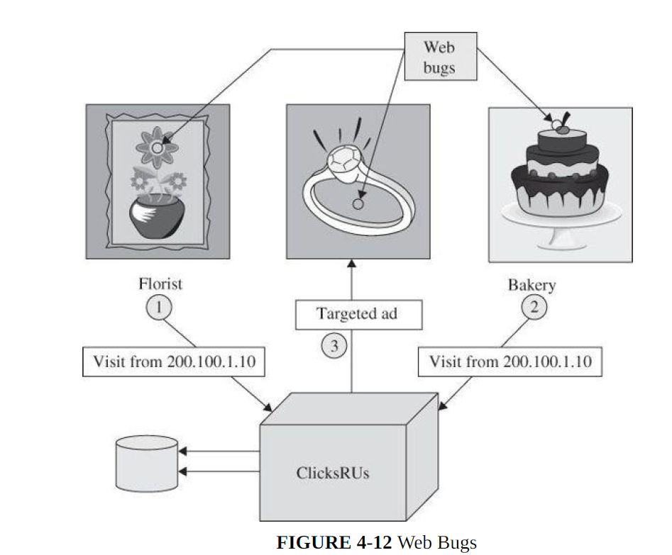

Slide 34
Web bugs can also be used in email with images.
A spammer gets a list of email addresses but does not know if the addresses are active, that is, if anyone reads mail at that address.
With an embedded web bug, the spammer receives a report when the email message is opened in a browser.
Or a company suspecting its email is ending up with competitors or other unauthorized parties can insert a web bug that will report each time the message is opened, whether as a direct recipient or someone to whom the message has been forwarded.

Slide 35
Clickjacking
Consider a scenario in which an attacker wants to seduce a victim into doing something.
As shown in Figure 4-13, the computer attack uses an image pasted over, that is,
displayed on top of, another image.
We are all familiar with the click box “Do you want to
delete this file? [Yes] [No].”
Clickjacking is a technique that essentially causes that prompt box to slide around so that [Yes] is always under the mouse.

Slide 36
The attacker also makes this box transparent, so the victim is unaware of clicking anything.
Furthermore, a second, visible image is pasted underneath, so the victim thinks the box being clicked is
something like “For a free prize, click [Here].”
The victim clicks where [Here] is on the screen, but [Here] is not a button at all; it is just a picture directly under [Yes] (which is invisible). The mouse click selects the [Yes] button.

Slide 37
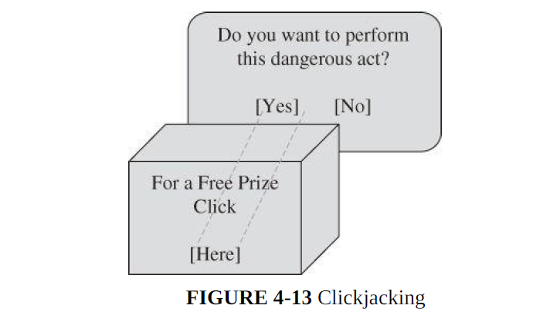

Slide 38
It is easy to see how this attack would be used. The attacker chooses an action to which the user would ordinarily not agree, such as
• Do you really want to delete all your files?
• Do you really want to send your contacts list to a spam merchant?
• Do you really want to install this program?
• Do you really want to change your password to A Word You Don’t Know?
• Do you really want to allow the world to have write access to your profile?

Slide 39
A clickjacking attack succeeds because of what the attacker can do:
• Choose and load a page with a confirmation box that commits the user to an action with one or a small number of mouse clicks (for example, “Do you want to install this program? [Yes] [Cancel]”)
• Change the image’s coloring to transparent.
• Move the image to any position on the screen.
• Superimpose a benign image underneath the malicious image (remember, the malicious image is transparent) with what looks like a button directly under the real (but invisible) button for the action the attacker wants (such as, “Yes” install the program).
• Induce the victim to click what seems to be a button on the benign image.

Slide 40
The two technical tasks, changing the color to transparent and moving the page, are both possible because of a technique called framing, or using an iframe.
An iframe is a structure that can contain all or part of a page, can be placed and moved anywhere on another page, and can be layered on top of or underneath other frames.
Although important for managing complex images and content, such as a box with scrolling to enter a long response on a feedback page, frames also facilitate clickjacking.

Slide 41
Web Attacks Targeting Users
False or Misleading Content
It is sometimes difficult to tell when an art work is authentic or a forgery; art experts can debate for years who the real artist is, and even when there is consensus, attribution of a da Vinci or Rembrandt painting is opinion, not certainty.
The case of computer artifacts is similar. An incoherent message, a web page riddled with grammatical errors, or a peculiar political position can all alert you that something is suspicious, but a well-crafted forgery may pass without question.
The falsehoods that follow include both obvious and subtle forgeries.

Slide 42
Defaced Web Site
The simplest attack, a website defacement, occurs when an attacker replaces or modifies the content of a legitimate web site.
For example, in January 2010, BBC reported that the web site of the incoming president of the European Union was defaced to present a picture of British comic actor Rowan Atkinson (Mr. Bean) instead of the president.
The nature of these attacks varies. Often the attacker just writes a message like “You have been had” over the web-page content to prove that the site has been hacked.
In other cases, the attacker posts a message opposing the message of the original web site, such a an animal rights group protesting mistreatment of animals at the site of a dog-racing
group.

Slide 43
Other changes are more subtle.
For example, recent political attacks have subtly replaced the content of a candidate’s own site to imply falsely that a candidate had said or done something unpopular.
Or using website modification as a first step, the attacker can redirect a link on the page to a malicious location, for example, to present a fake login box and obtain the victim’s login ID and password.
All these attacks attempt to defeat the integrity of the web page.

Slide 44
The objectives of website defacements also vary. Sometimes the goal is just to prove a point or embarrass the victim.
Some attackers seek to make a political or ideological statement, whereas others seek only attention or respect.
In some cases the attacker is showing a point, proving that it was possible to defeat integrity.
Sites such as those of the New York Times, the U.S.
Defense Department or FBI, and political parties were frequently targeted this way.

Slide 45
A defacement is common not only because of its visibility but also because of the ease with which one can be done.
Web sites are designed so that their code is downloaded, enabling an attacker to obtain the full hypertext document and all programs directed to the client in the loading process.
An attacker can even view programmers’ comments left in as they built or maintained the code.
The download process essentially gives the attacker the blueprints to the web site.

Slide 46
Fake Web Site
A similar attack involves a fake web site. In Figure 4-7 we show a fake version of the web site of Barclays Bank (England) at http://www.gb-bclayuk.com/.
The real Barclays site is at http://group.barclays.com/Home. the forger had some trouble with the top image, but if that were fixed, the remainder of the site would look convincing

Slide 47
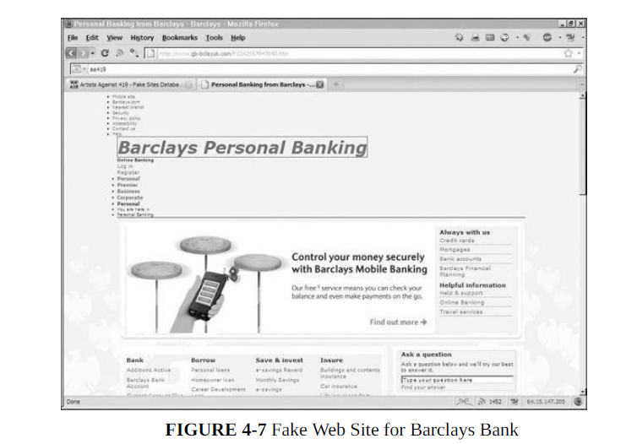

Slide 48
Web sites are easy to fake because the attacker can obtain copies of the images the real site uses to generate its web site.
All the attacker has to do is change the values of links to redirect the unsuspecting victim to points of the attacker’s choosing.
The attacker can get all the images a real site uses; fake sites can look convincing.

Slide 49
Fake Code
Opening of a document or clicking a link can lead to a surreptitious download of code that does nothing obvious but installs a hidden infection.
One transmission route we did not note was an explicit download: programs intentionally installed that may advertise one purpose but do something entirely different.
Figure 4-8 shows a seemingly authentic ad for a replacement or update to the popular Adobe Reader.
The link from which it came (www.pdf-new-2010-download.com) was redirected from www.adobe-download-center.com; both addresses seem like the kinds of URLs Adobe might use to distribute legitimate software.

Slide 50
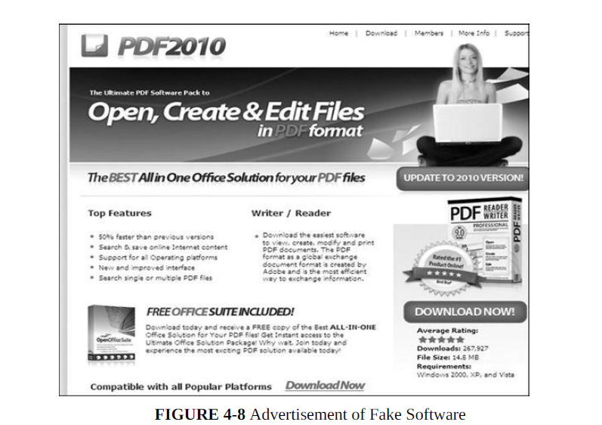

Slide 51
Whether this attack is meant just to deceive or to harm depends on what code is actually delivered.
This example shows how malicious software can masquerade as legitimate.
The charade can continue unnoticed for some time if the malware at least seems to implement its ostensible function, in this case, displaying and creating PDF documents.
Perhaps the easiest way for a malicious code writer to install code on a target machine is to create an application that a user willingly downloads and installs.

Slide 52
Protecting Web Sites Against Change
A web site is meant to be accessed by clients. Although some web sites are intended for authorized clients only and restricted by passwords or other access controls, other sites are intended for the general public.
Thus, any controls on content have to be unobtrusive, not
limiting proper use by the vast majority of users.
Our favorite integrity control, encryption, is often inappropriate: Distributing decryption keys to all users defeats the effectiveness of encryption.
However, two uses of encryption can help keep a site’s content intact.

Slide 53
Integrity Checksums
A checksum, hash code, or error detection code is a mathematical function that reduces a block of data (including an executable program) to a small number of bits.
Changing the data affects the function’s result in mostly unpredictable ways, meaning that it is difficult—although not impossible—to change the data in such a way that the resulting function value is not changed.
Using a checksum, you trust or hope that significant changes will invalidate the checksum value.

Slide 54
Integrity checksums can detect altered content on a web site.
To detect data modification, administrators use integrity-checking tools, of which the Tripwire program is the most well known.
When placing code or data on a server an administrator runs Tripwire to generate a hash value for each file or other data item.
These hash values must be saved in a secure place, generally offline or on a network separate from the protected data, so that no intruder can modify them while modifying the sensitive data.
The administrator reruns Tripwire as often as appropriate and compares the new and original hash values to determine if
changes have occurred.

Slide 55
Signed Code or Data
Using an integrity checker helps the server-side administrator know that data are intact; it provides no assurance to the client.
A similar, but more complicated approach works for clients, as well.
The problem of downloading faulty code or other data because of its being supplied by a malicious intruder can also be handled by an outside attestation.
Digital signature is an electronic seal that can vouch for the authenticity of a file or other data object.
The recipient can inspect the seal to verify that it came from the person or organization believed to have signed the object and that the object was not modified after it was signed.
A partial approach to reducing the risk of false code is signed code.

Slide 56
Users can hold downloaded code until they inspect the seal.
After verifying that the seal is authentic and covers the entire code file being downloaded, users can install the code obtained.
A digital signature can vouch for the authenticity of a program, update, or dataset.
The problem is, trusting the legitimacy of the signer.

Slide 57
Drive-By Download
Similar to the clickjacking attack, a drive-by download is an attack in which code is downloaded, installed, and executed on a computer without the user’s permission and usually without the user’s knowledge.
In one example of a drive-by download, in April 2011, a web page from the U.S. Postal Service was compromised with the Blackhole commercial malicious-exploit kit.
Clicking a link on the postal service website redirected the user to a website in Russia, which presented what looked like a familiar “Error 404— Page Not Found” message, but instead the Russian site installed malicious code carefully matched to the user’s browser and operating system type.
A drive-by download is downloading and installing code other than what a user expects.

Slide 58
Protecting Against Malicious Web Pages
The basic protection against malicious web content is access control.
Access control accomplishes separation, keeping two classes of things apart.
We want to keep malicious code off the user’s system in this context.
The relevant measures here would include least privilege, user training, and visibility.
The other control is the responsibility of the web page owner to ensure that the code on a web page is good, clean, or suitable.

Slide 59
Obtaining User or Website Data
The common factor in these attacks is that computer commands provide the website content.
The commands form a language that is often widely known.
For example, almost all database management systems process commands in a language known as SQL, which stands for System Query Language.
Someone interested in obtaining unauthorized data from the background database server crafts and passes SQL commands to the server through the web interface.
Similar attacks involve writing scripts in Java.
These attacks are called scripting or injection attacks because the unauthorized request is delivered as a script or injected into the dialog with the server.

Slide 60
Code Within Data
Cross-Site Scripting :
To a user (client) it seems as if interaction with a server is a direct link, so it is easy to ignore the possibility of falsification along the way.
However, many web interactions involve several parties, not just the simple case of one client to one server.
In an attack called cross-site scripting, executable code is included in the interaction between client and server and executed by the client or server.

Slide 61
As an example, consider a simple command to the search engine Google.
The user enters a simple text query, but handlers add commands along the way to the server,
So what starts as a simple string becomes a structure that Google can use to interpret or refine the search, or that the user’s browser can use to help display the results.
Scripting attack is forcing the server to execute commands (a script) in a normal data fetch request.

Slide 62
SQL Injection
Cross-site scripting attacks are one example of the category of injection attacks, in which malicious content is inserted into a valid client-server exchange.
Another injection attack, called SQL injection, operates by inserting code into an exchange between a client and a database server.
QUERY = “SELECT * FROM trans WHERE acct=‘2468’ OR ‘1’=‘1’”
Because ‘1’=‘1’ is always TRUE, the OR of the two parts of the WHERE clause is always TRUE, every record satisfies the value of the WHERE clause and so the DBMS will return all records in the database.
The trick here, as with cross-site scripting, is that the browser application includes direct user input into the command, and the user can force the server to execute arbitrary SQL commands.

Slide 63
Dot-Dot-Slash
Web-server code should always run in a constrained environment.
Ideally, the web server should never have editors, xterm and Telnet programs, or even most system utilities loaded.
By constraining the environment in this way, even if an attacker escapes from the web-server application, no other executable programs will help the attacker use the web server’s computer and operating system to extend the attack.
The code and data for web applications can be transferred manually to a web server or pushed as a raw image.

Slide 64
Enter the dot-dot. In both Unix and Windows, ‘..’ is the directory indicator for “predecessor.”
And ‘../..’ is the grandparent of the current location.
So someone who can enter file names can travel back up the directory tree one .. at a time.
Cerberus Information Security analysts found just that vulnerability in the webhits.dll extension for the Microsoft Index Server.
For example, passing the following URL causes the server to return the requested file, autoexec.nt, enabling an attacker to modify or delete it.

Slide 65
Foiling Data Attacks
An input preprocessor could watch for and filter out specific inappropriate string forms, such as < and > in data expected to contain only letters and numbers.
However, to support input from different keyboard types and in different languages, some browsers encode special characters in a numeric format, making such input slightly more difficult to filter.
The second countermeasure that applies is access control on the part of backend servers that might receive and execute these data attacks.

Slide 66
For example, a database of names and telephone numbers might support queries for a single person.
To assist users who are unsure of the spelling of some names, the application might support a wildcard notation, such as AAR* to obtain names and numbers of all people whose name begins with AAR.
If the number of matching names is under a predetermined threshold, for example 10, the system would return all matching names.
But if the query produces too many matches, the system could return an error indication.

